Slide 1
INVESTMENTS REQUIREMENTS
CORPORATE & TAX
Peru Meeting June 2012
Lima, Peru
César Luna-Victoria León

Slide 2
Corporate
Setting up a bussiness presence in Peru
Options
  Branch (local incomes)
  Subsidiary (world wide incomes)
  Joint Venture
Peruvians = Foreigners
Residents vs Non residents

Slide 3
Main Taxes
IT (Income Tax) 30%?
VAT (Value Added Tax) 18%

Slide 4
IT – Income Tax
i
(e)
100
(30)
70
(3)
67
IT Corporate 30%
33%
IT Profits 4.1%

Slide 5
IT + W Protif Sharing
i + x
(e)
100 + x
(x)
100
(30)
70
(3)
67
W Profit Sharing
33% + x
IT Corporate 30%
IT Profits 4.1%

Slide 6
W Profit Sharing
10% Fishing, telecomunications, industrial
8% mining, whosale and retail, restaurants
5% others
0% small bussines, professional services

Slide 7
IT - Spots
Accrual basis
IAS (NIC’s) or Peruvian NIFF’s
Market Value / Transfer pricing rules (OECD)
Preoperative expenses: 1 or 10 years
Shorter depreciation term
IT advances payments / monthly
Losses carry on (System A or B)

Slide 8
IT - Financing
Related parties
  Transfer pricing rules
  Thin capitalization 3 x 1
  Witholding 30%
Non related parties
  Thin capitalization not applicable
  Witholding:
    4.99% up to Libor + 7
    30% for the excess
  No back to back

Slide 9
IT – Capital Gains
30 % real state
5% MILA stock market
30% others

Slide 10
IT – Services from non residents
Performed in or outside Peru
  30% royalties
  30% digital services
  15% technical assistance
Other services
  30% performed in Peru
  0% not performed in Peru

Slide 11
Other Taxes
0.4% x assets (minimum income tax) (ITAN)
0.005% financial transactions tax (ITF)
Local Tax
  Up to 1% Real Estate Property Tax
  1% Motor Vehicular Property Tax
  3% Real Estate Transfer Tax

Slide 12
Mining Special Regime
Special mining burden (GEM)
Special mining tax (IEM)
Modified royalty

Slide 13
Tax Treaties
^{[1]}
Item of Income
Countries |  | Interest | Dividends | Royalties | General Services | Technical Assistance
 | COLOMBIA | Unlimited source taxation only(*)
 | BOLIVIA | Unlimited source taxation only(*)
 | ECUADOR | Unlimited source taxation only(*)
 | CHILE | 15% | 10%-15% | 15% | Residence taxation, unless a Permanent Establishment in the Source State.
 | CANADA | 15% | 10%-15% | 15% | Residence taxation, unless a Permanent Establishment in the Source State.
 | BRASIL | 15% | 10%-15% | 15% | 15 %
(*) Under Andean Community Decision to avoid international double taxation.^{[1]}
Oficina de Lima.

Slide 14
Payroll Taxes
 | Corporate | Employee
Income Tax |  | 0 – 30
Health contributions | 9%
Pension Fund |  | 11% - 12%
Benefits
Minimum salary
2 Legal Bonuses/year
Labor risks insurance
Profit-Sharing
CTS – Compensation for Retirement

Slide 15
Expatries - Witholding
24% independent – professional services
30% employment
15% live shows performed by artists
30% others

Slide 16
VAT
18%
Recover VAT
  Fiscal credit
  Early recovery
  Export reimbursement

Slide 17
Investments Warranties
Constitutionals
Stability agreements
International arbitration
  MIGA
  CIADI
  TLC Canada/Peru

Slide 18
¿Fiscal Turbulence?
❒ Fiscal Needs | % PBI | % PBI | ❒ Potential Incomes
Poverty eradication | 1.0 | 3.0 | Tax burden
Health | 1.7 | 4.0 | Unexecuted budget
Education | 1.9 | 5.0 | Tax evasion
Kuntur | 0.6 | 1.9 | Fiscal costs
Infrastructure gap | 1.9 | -.- | -.-
Total | 7.1 | 13.9 | Total

Slide 20
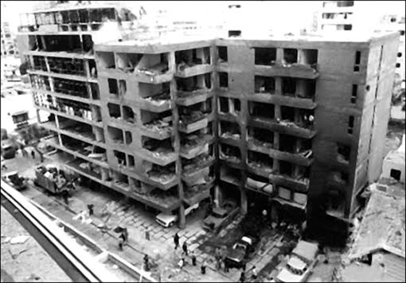

Slide 21
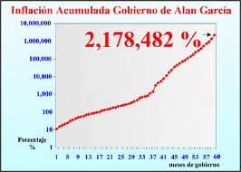

Slide 22
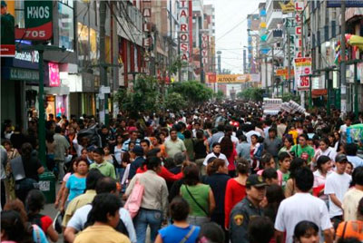

Slide 23
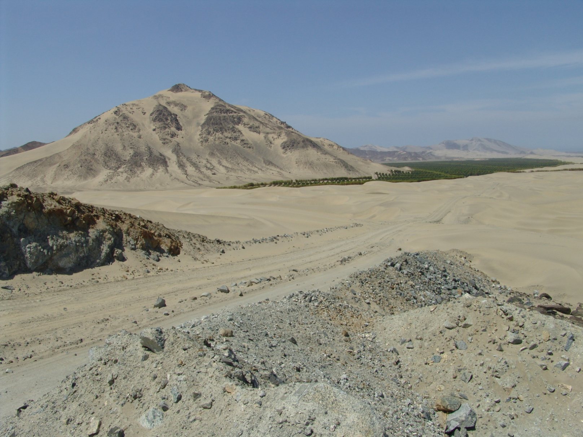

Slide 24


Slide 25
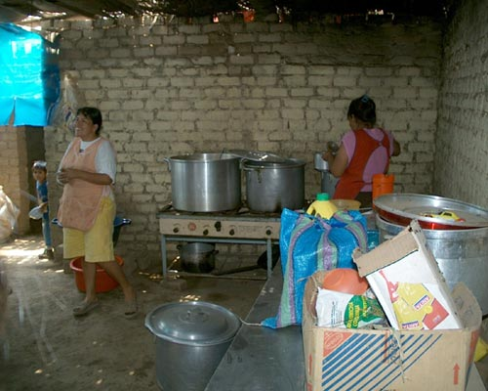

Slide 26


Slide 27



Slide 28
Many thanks
César Luna-Victoria
clunavictoria@rubio.pe
www.rubio.pe
51 945 094 557

